Slide 1


Iran War Ceasefire
Power and Security
Why is a lasting peace so difficult to achieve?

Slide 2
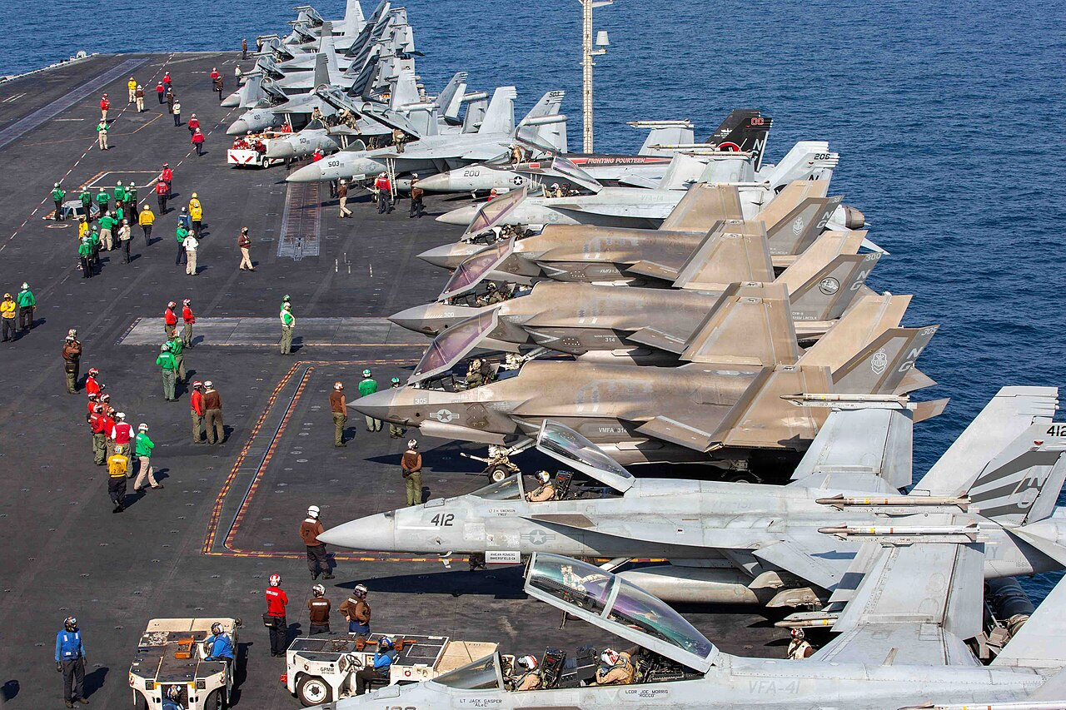
Why is it challenging to stop a conflict?
Discuss the question with a neighbour, be prepared to discuss as a class.
Notes:
What to listen for:
Students will likely focus on practical reasons ("both sides are angry," "they don't trust each other"). Affirm these, they’re accurate – but push them further.
Some students may surface ideas around interests, conditions, and leverage. Prompt them to be specific: whose interests? what kind of trust?
Listen for the words trust, power, and fairness — if they come up organically, flag them: "Hold onto that word — we're going to come back to it."
Useful prompts if the discussion stalls:
"Think about an argument you've had — what made it hard to stop, even when you wanted to?"
"Is stopping a conflict the same as solving a conflict? What's the difference?"
"Who has to agree before a war can end — just the leaders, or other people too?"
Redirection if students jump to this specific conflict too fast: If students immediately go to the US/Iran case before reading, gently hold them back: "Great instinct — let's hold that thought and come back to it after you've read. I want to see if your answer changes."
Concept seeds to plant (don't define yet — just name): Before moving to the readings, you can say: "Today we're going to look at two ideas — power and security — and use them to understand why this particular ceasefire happened, and why peace is still not guaranteed." That's enough framing. Let the readings do the rest.

Slide 3
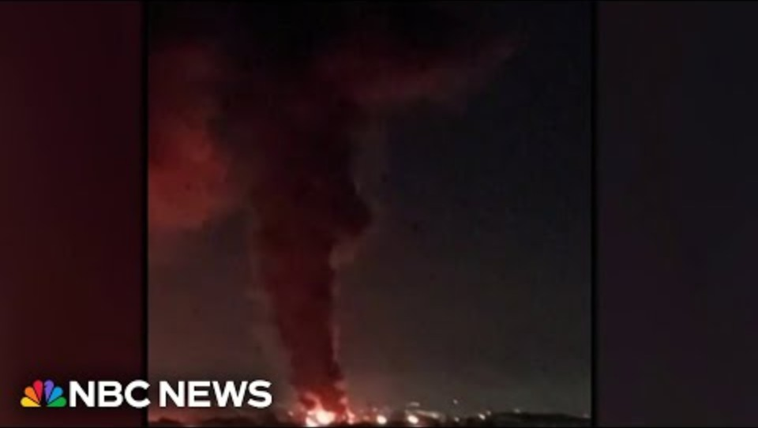
What did the USA and Iran agree to?

Slide 4
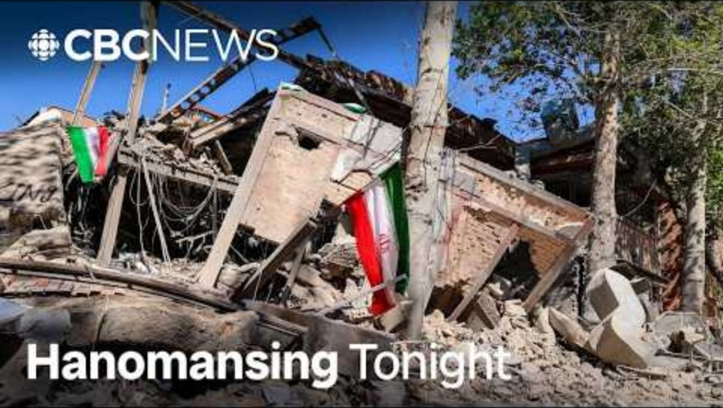
What was Pakistan’s role in the ceasefire?

Slide 5
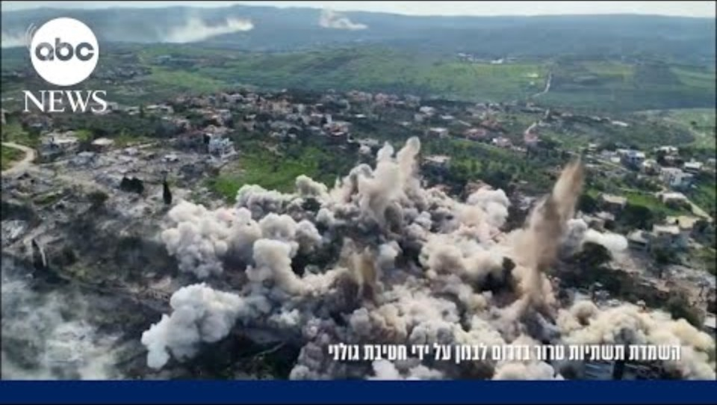
What are the challenges the ceasefire is already facing?

Slide 6
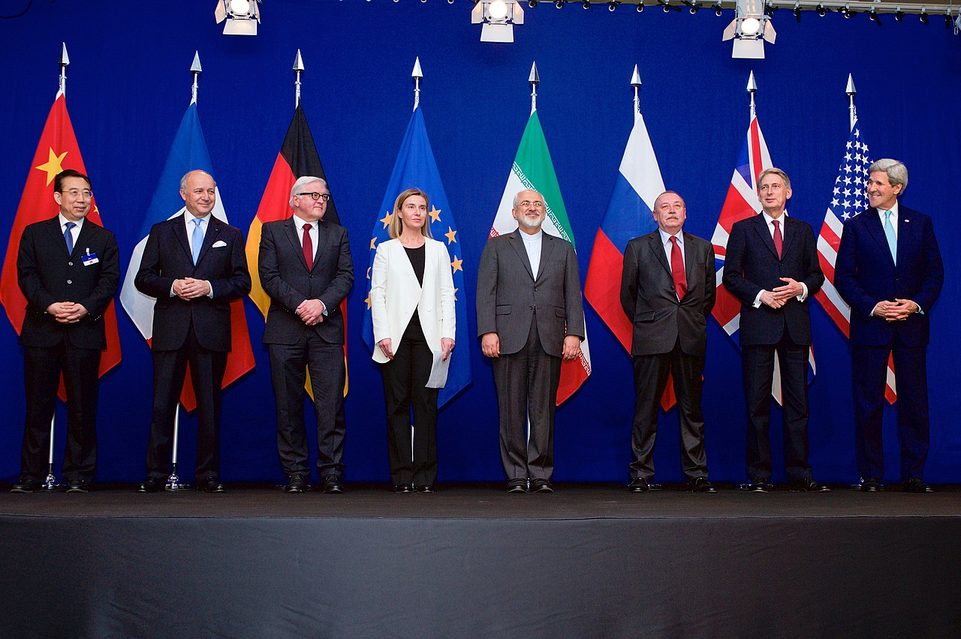
Further Research
Research the Iran Nuclear Deal (2015), also known as the Joint Comprehensive Plan of Action.
  What was it meant to achieve?
  Why did the USA leave the deal in 2018, and why was it abandoned in 2025?
Notes:
By United States Department of State - https://www.flickr.com/photos/statephotos/16389773974, Public Domain, https://commons.wikimedia.org/w/index.php?curid=39364779

