Slide 1
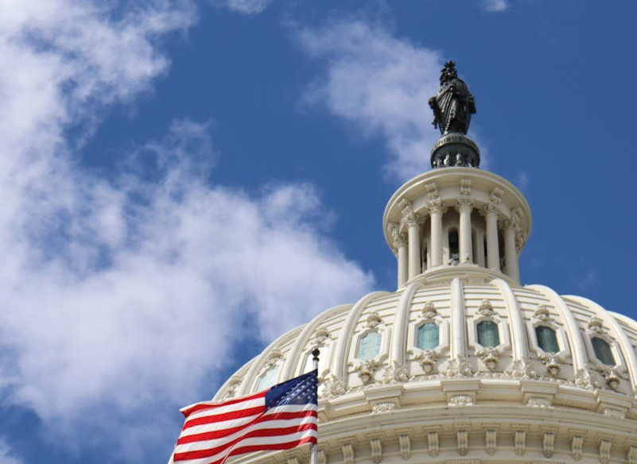

What is Legitimacy?
Why do we accept our government’s right to rule?
Notes:
Some slides are a bit dense – feel free to adapt to suit the needs of your class.
Photo by Ilkauri Scheer: https://www.pexels.com/photo/united-states-capitol-in-washington-dc-in-usa-25819424/

Slide 2

Why do we obey laws?
Make a list of as many reasons you can think of.
Notes:
"Because we'll get in trouble" → Ask: what if there were no police? Would all laws disappear? Do you only follow rules when someone’s watching? Nudge toward the idea that enforcement alone can't explain why we comply with laws.
"Because it's fair" → Ask: who decides what's fair? What if you think a law is unfair, do you still follow it?
"Because everyone else does" → Good entry point for social norms and legitimacy as a collective belief, not just an individual one.
"Because we agreed to them / we voted" → This is the concept of consent – very closely tied to legitimacy
Remind students this is a question philosophers have debated for centuries and there's no single correct answer.
Photo by Nataliya Vaitkevich: https://www.pexels.com/photo/red-and-white-stop-sign-5712833/

Slide 3
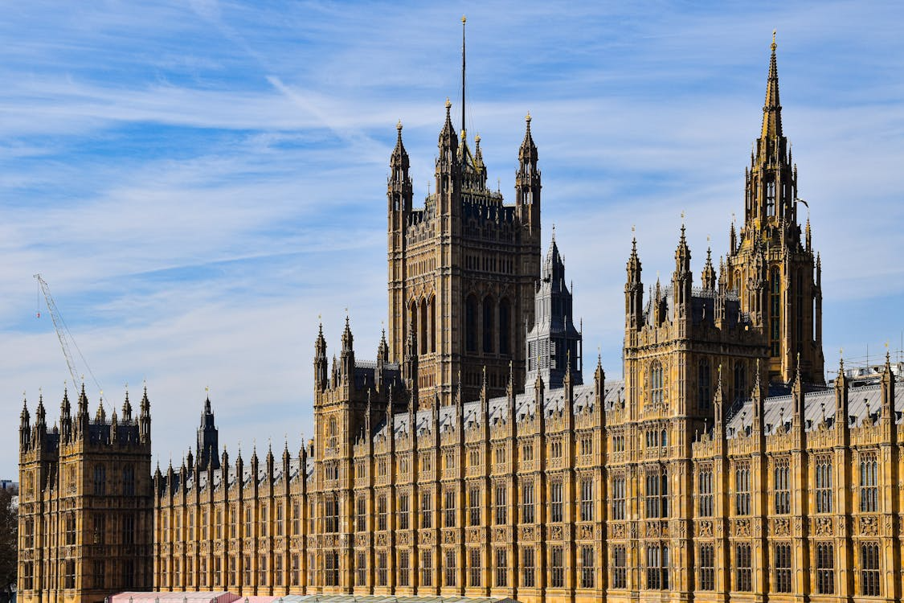
Legitimacy – Concept Explained
Legitimacy is the idea that a government or authority has the right to rule. People accept its power, because they believe it is fair, lawful, or properly chosen.

Slide 4
Legitimacy – Concept Explained
Legitimacy is the idea that a government or authority has the right to rule. People accept its power, because they believe it is fair, lawful, or properly chosen.
So then – what are some of the reasons people accept their government’s right to rule?
Notes:
"We voted for them" → Democratic consent. This might be the most familiar source for most students. Ask: what about people who voted for the losing side?
"They keep us safe" → Performance-based legitimacy. Ask: if a government kept you safe but ignored your rights, would it still be legitimate?
"It's always been that way" → Traditional legitimacy (Connected to Weber’s three types of authority). Ask: is something legitimate just because it's old?
"The law says they're in charge" → Legal-rational legitimacy (Weber). Ask: what if the law itself was written unfairly?
"They're a strong/inspiring leader" → Charismatic legitimacy (Weber). Ask: what's the risk of basing legitimacy on one person?
Teaching suggestion: Write the responses on the board. When you look at Max Weber’s three types of authority on the next slide, see how many students naturally came up with?
Photo by AXP Photography: https://www.pexels.com/photo/house-of-parliament-in-london-18729241/

Slide 5
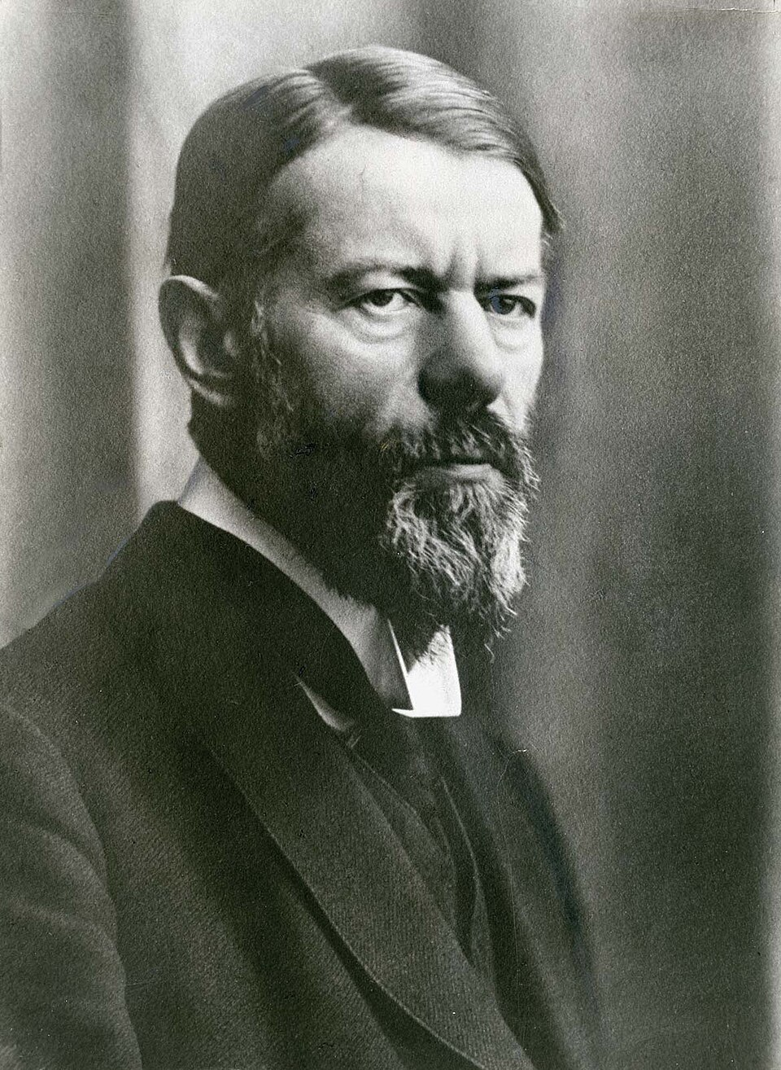
Max Weber’s Three Types of Authority
Traditional Authority – based on long standing traditions and the ‘way things have always been done’. The systems that govern society are rarely questioned.
Charismatic Authority – based on the qualities of an individual leader and their ability to connect with people.
Legal-rational authority – based on rules and legal systems. Power doesn’t come from the individual but from the rules governing their position. Most common in modern democracies.
Notes:
How many can you connect to from the previous discussions?

Slide 6
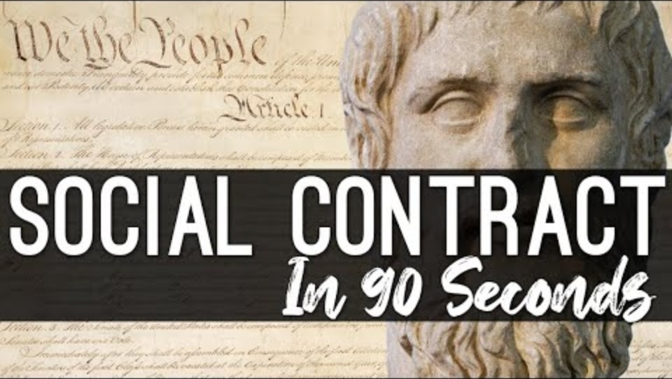
Social Contract Theory
During the enlightenment in the 17th Century, philosophers challenged the ‘Divine Right of Kings’. That legitimacy of rulers came from God.
Social Contract Theory emerged with the belief that people should willingly give up some freedom to a government because we need someone to handle law and order to have a functioning society. HOWEVER – that power comes from the consent of the people, not God.
Notes:
There’s a lot to talk about here. Hobbes, Locke, and Rousseau are some of the central Social Contract philosophers.
I have some YouTube videos that can stimulate some discussion here:
Hobbes, Locke, and Rousseau Explained – https://www.youtube.com/watch?v=glgU6o4nZQc
Social Contract Theory in the Modern Day - https://www.youtube.com/watch?v=ZPaaDBqoiQ8

Slide 7
Separation of Powers and Legitimacy
Legislative: Makes the Laws
Executive: Puts laws into action
Judicial: Enforces and makes judgement on laws
Attributed to Baron de Montesquieu and his The Spirit of Laws, 1748
For a democracy to be legitimate, power needs to be separated into equal branches to prevent any one from becoming too powerful
Also called ‘checks and balances’

Slide 8
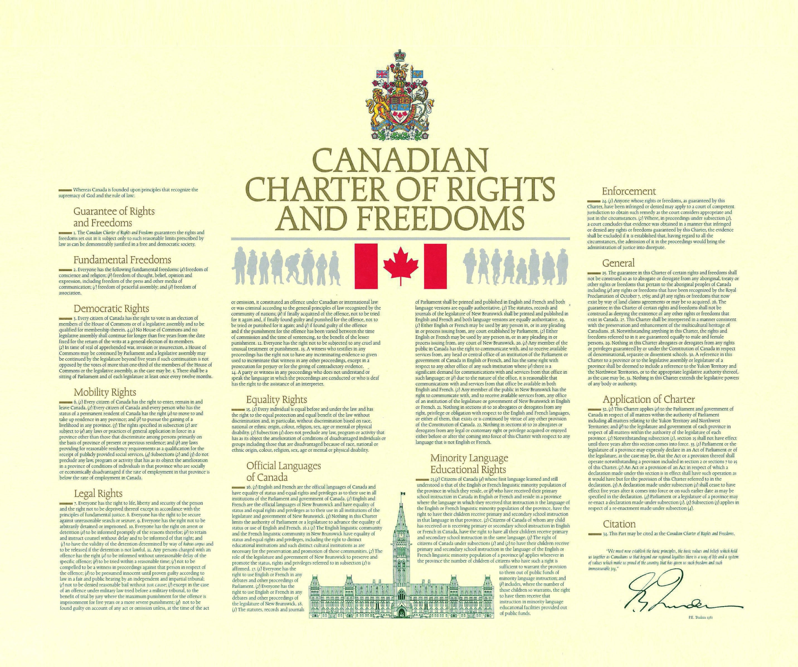
Rule of Law
One of the most important ideas in the legitimacy of modern democratic societies. That everyone, including those in power, are subject to the same law as everyone else.

Slide 9

How can legitimacy be seen differently?

Slide 10
The many sources of legitimacy
History | Ideology | National Identity | Leadership Recognition | Government Performance
Free and Fair Elections | Representation | Consent of the Governed | Transparency | Citizen Welfare
Order and Stability | Economic, social, and political development | Sustained Development | International Recognition | Quality of Governance
Notes:
Check the handout for an activity related to these sources

Slide 11

Review: Legitimacy

