Slide 1
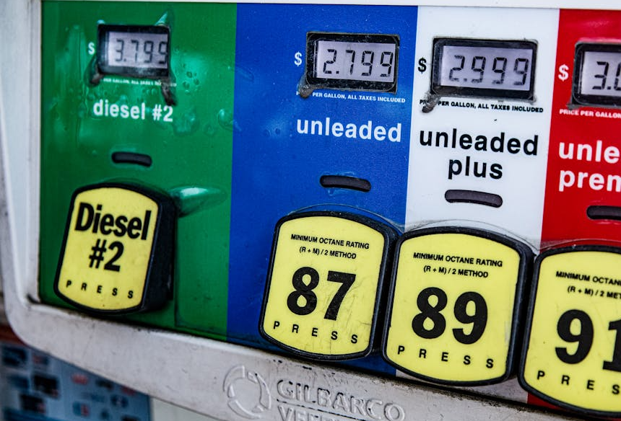

2026 Global
Energy Crisis
Inequality and Interdependence
Why does the same global crisis hurt some places more than others?
Notes:
Photo by Ekaterina Belinskaya: https://www.pexels.com/photo/close-up-photo-gasoline-fuel-pump-4744707/

Slide 2
Global Gas Prices: Before & After the Iran War
National average pump prices (USD/gallon) · Regular Unleaded · Feb 23, 2026 → Late Apr 2026 ·
COUNTRY
FEB 23
LATE APR
CHANGE
GOVERNMENT RESPONSE
PH
Philippines
$2.73
$4.69
+72.6%
State of national energy emergency declared; fuel tax suspended; free bus rides for students & workers; 4-day work week
KH
Cambodia
$3.6
$5.03
+40.4%
Import duties & VAT on fuel eliminated; diversified supply away from Thailand to Singapore & Malaysia
US
United States
$3.26
$4.39
+35.1%
IEA coordinated reserve release (400 mb); Strategic Petroleum Reserve drawdown; no federal fuel tax cut enacted
AU
Australia
$4.01
$5.19
+29.3%
Strategic reserve release; fuel quality standards relaxed; 'Every Little Bit Helps' conservation campaign; Singapore supply deal
CA
Canada
$3.97
$5.11
+28.9%
Federal carbon tax suspended; IEA reserve release participation; cost-of-living rebates to lower-income households
GB
United Kingdom
$5.11
$6.13
+20%
IEA reserve release; emergency household energy support payments; windfall tax on oil company profits extended
DE
Germany
$6.59
$7.8
+18.6%
Petrol station price regulation (anti-gouging); IEA reserve release; EU coordinated response; work-from-home guidance
SG
Singapore
$7.5
$8.48
+13.3%
Diversified crude supply origins; bilateral energy trade deal with Australia; leveraged financial reserves; refinery stabilisation
JP
Japan
$3.71
$4.01
+8.2%
Released 80 million barrels (15 days' demand) from strategic reserves; fuel subsidy programme extended; urged conservation
Sources: Visual Capitalist · GlobalPetrolPrices.com · IEA 2026 Energy Crisis Policy Response Tracker · Wikipedia 2026 Iran war fuel crisis
currenteventshub.com
Notes:
This slide is price per gallon for teachers in the USA. Next slide uses USD/litre price. Use whichever one suits your context better. Note – gas/petrol prices are highly variable across a country/city, so the stats might not be perfect. I did my best to try an find accurate comparisons, and even if not perfect, the % change should be pretty close.
Discussion – Ask: ‘What observations can you make about this chart?’
Give students a few minutes to discuss with a neighbour.
Students should identify that some countries had a larger change than others
Follow up question: ‘What effects might there be when the price of gas/petrol increases so much?’
Probe students to consider the effects in higher income countries vs. lower income countries.
Another question: ‘What might have caused this?’
Students might connect it to the Iran War – a major part of this lesson
Printed handout will have a follow-up task involving this data

Slide 3
Global Gas Prices: Before & After the Iran War
National average pump prices (USD/litre) · Regular Unleaded · Feb 23, 2026 → Late Apr 2026
COUNTRY
FEB 23
LATE APR
CHANGE
GOVERNMENT RESPONSE
PH
Philippines
$0.72
$1.24
+72.6%
State of national energy emergency declared; fuel tax suspended; free bus rides for students & workers; 4-day work week
KH
Cambodia
$0.95
$1.33
+40.4%
Import duties & VAT on fuel eliminated; diversified supply away from Thailand to Singapore & Malaysia
US
United States
$0.86
$1.16
+35.1%
IEA coordinated reserve release (400 mb); Strategic Petroleum Reserve drawdown; no federal fuel tax cut enacted
AU
Australia
$1.06
$1.37
+29.3%
Strategic reserve release; fuel quality standards relaxed; 'Every Little Bit Helps' conservation campaign; Singapore supply deal
CA
Canada
$1.05
$1.35
+28.9%
Federal carbon tax suspended; IEA reserve release participation; cost-of-living rebates to lower-income households
GB
United Kingdom
$1.35
$1.62
+20%
IEA reserve release; emergency household energy support payments; windfall tax on oil company profits extended
DE
Germany
$1.74
$2.06
+18.6%
Petrol station price regulation (anti-gouging); IEA reserve release; EU coordinated response; work-from-home guidance
SG
Singapore
$1.98
$2.24
+13.3%
Diversified crude supply origins; bilateral energy trade deal with Australia; leveraged financial reserves; refinery stabilisation
JP
Japan
$0.98
$1.06
+8.2%
Released 80 million barrels (15 days' demand) from strategic reserves; fuel subsidy programme extended; urged conservation
Sources: Visual Capitalist · GlobalPetrolPrices.com · IEA 2026 Energy Crisis Policy Response Tracker · Wikipedia 2026 Iran war fuel crisis
currenteventshub.com
Notes:
In Canada? – Feel free to change ‘petrol’ to ‘gas’. Note – gas/petrol prices are highly variable across a country/city, so the stats might not be perfect. I did my best to try an find accurate comparisons, and even if not perfect, the % change should be pretty close.
Discussion – Ask: ‘What observations can you make about this chart?’
Give students a few minutes to discuss with a neighbour.
Students should identify that some countries had a larger change than others
Follow up question: ‘What effects might there be when the price of gas/petrol increases so much?’
Probe students to consider the effects in higher income countries vs. lower income countries.
Another question: ‘What might have caused this?’
Students might connect it to the Iran War – a major part of this lesson
Printed handout will have a follow-up task involving this data

Slide 4
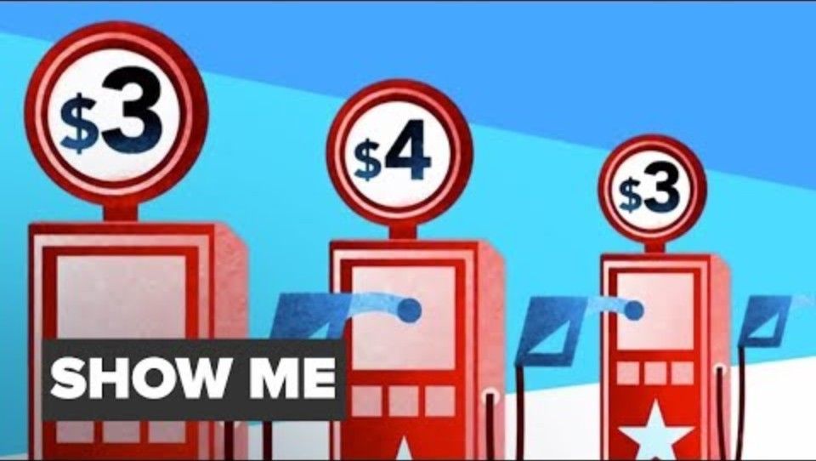
What affects the price of gas/petrol?

Slide 5

What are the reasons gas/petrol prices are rising now?

Slide 6
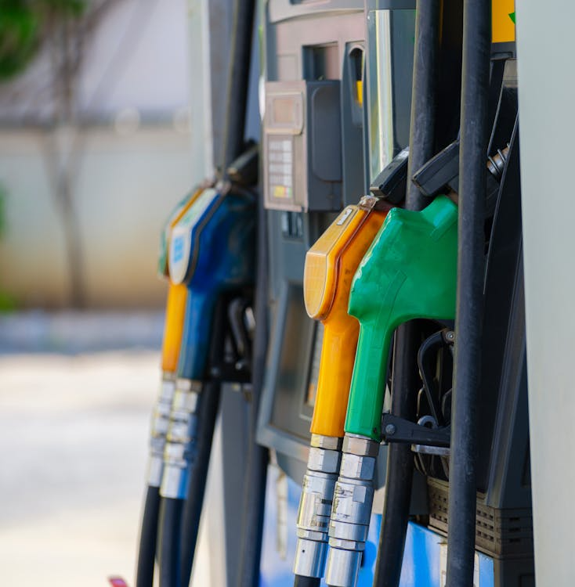
What effects might we see from rising oil/gas/petrol prices?
Make a list. Consider effects at different levels:
  Individual
  National
  Global
Notes:
If discussion stalls after the obvious answers, push with:
"Think beyond the car, where else does oil show up in daily life?"
"How do the things you buy actually get to the store?"
"What about farmers? what do they need oil for?"

Slide 7

How is the crisis affecting farmers?

Slide 8
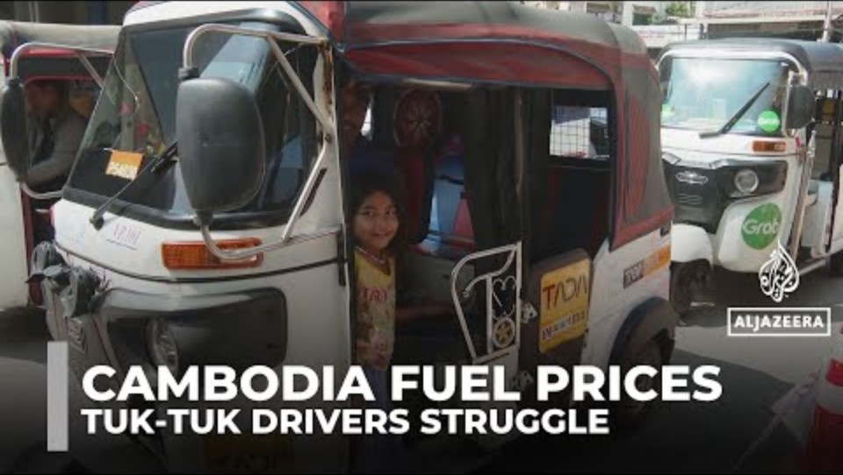
How is the fuel crisis affecting Cambodia?
Notes:
Have students make connections that for higher income countries, the pain is mostly felt through higher prices – lower income countries are more affected. In this case, the supply chain disruptions are making the situation for people that rely on fuel extremely challenging.

Slide 9
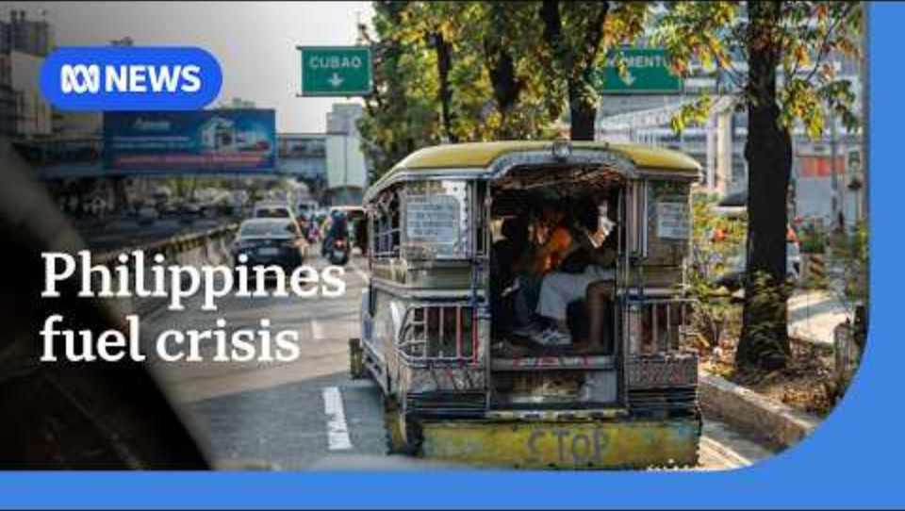
In the Philippines

Slide 10
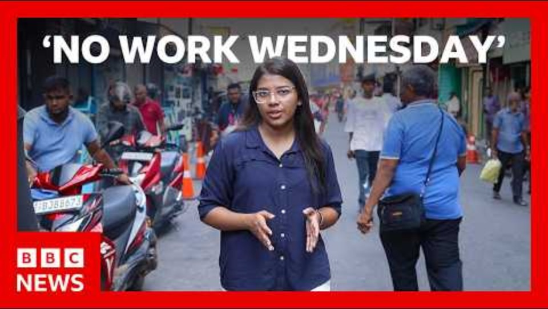
What steps has Sri Lanka taken?
Notes:
Just one example of many different ways government around the world are responding.

Slide 11
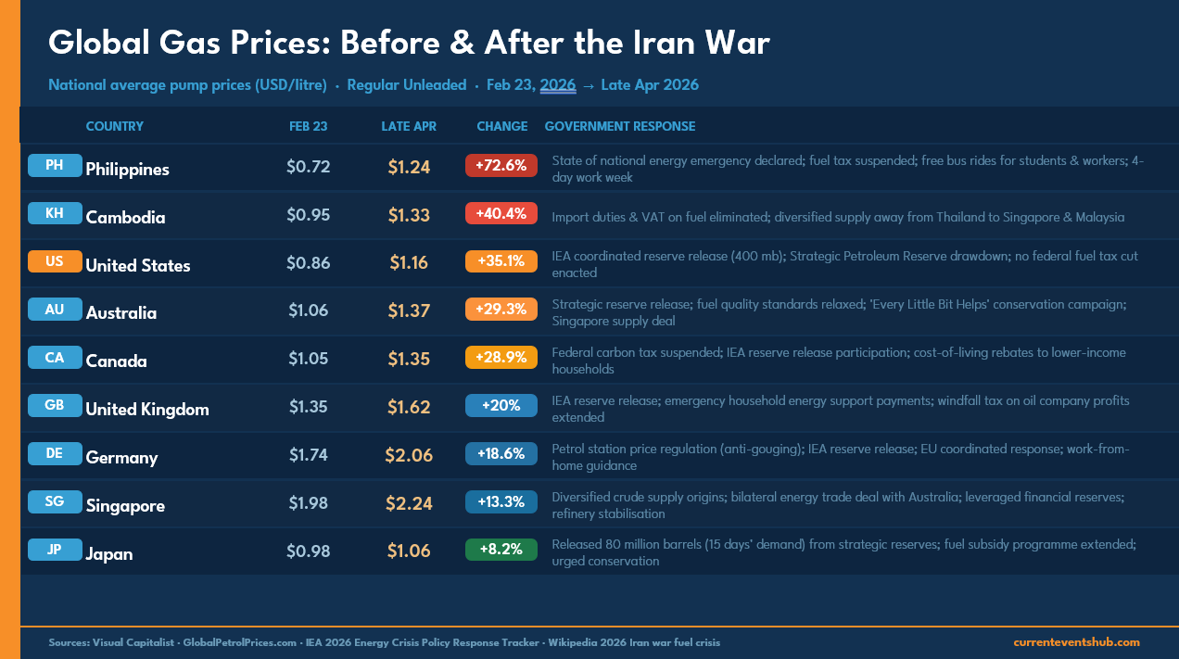
Research Extension
Pick two of the countries from the list we saw earlier. What are some things their government is doing to try and lessen the effects of the energy crisis?
Notes:
Really neat comparison tool to gauge responses to the crisis in different countries can be found here: https://www.iea.org/data-and-statistics/data-tools/2026-energy-crisis-policy-response-tracker

