Slide 1
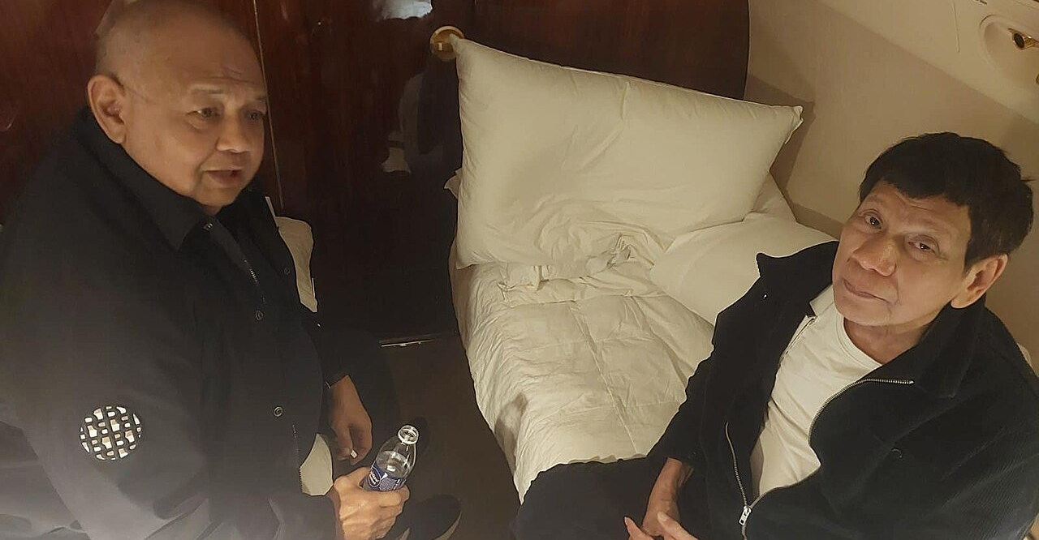

ICC Trial:
Rodrigo Duterte
Power and Interdependence
How effective are our systems of enforcing human rights?
Notes:
Former Philippine President Rodrigo Duterte and former Executive Secretary Salvador Medialdea were on board the jet to The Hague on March 11, 2025, for Duterte's trial at the International Criminal Court. By Senator Bong Go - Bong Go's official Facebook page, Public Domain, https://commons.wikimedia.org/w/index.php?curid=162067562

Slide 2
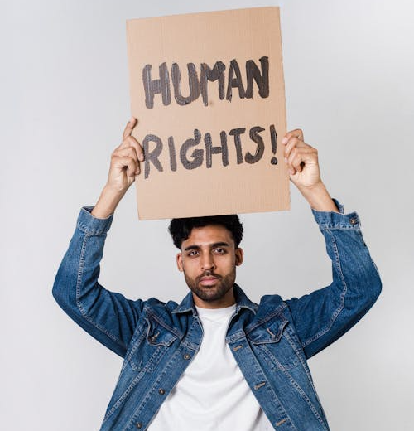
When someone violates human rights – what should be done about it?
If someone – a person, police officer, or even a president seriously violated another person’s human rights, what should happen?
Who should be responsible for doing something about it?
Notes:
Ask students to write their answer individually for 90 seconds before any sharing. Guide students to consider an individual case where a court system can deal with it, but what happens when a country or its leader is responsible for the violations?
Anticipated Responses and Follow-Up Prompts
"They should go to jail / be punished." "Who has the power to make that happen? What if the person who committed the violation is the one running the courts?"
"Other countries should do something." "What gives them the right? What if they have trade deals with that country and don't want to upset them?"
"The UN should step in." "What tools does the UN actually have? Can it arrest anyone?" Level 1 and 2 students likely won’t know the answer – that’s fine, the rest of this lesson will get there.
"Nothing can be done. Powerful people always get away with it." Don't dismiss this. It reflects a real pattern. Respond with: "That's often true. So what would need to change for that not to be true? What conditions would have to exist?"
"The people should protest / vote them out." "What if the leader is genuinely popular? Does popularity affect whether something is right or wrong? Does it affect whether someone is held accountable?"

Slide 3
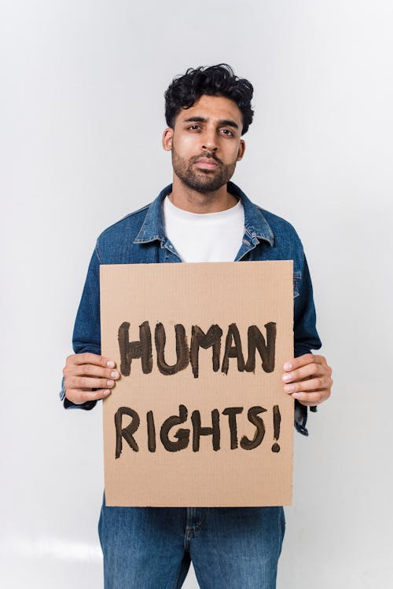
Why can it be difficult to enforce human rights?
What are some of the challenges of enforcing human rights?
Things to consider:
  Where human rights happen
  Who the violators are
  National means of enforcement vs. international means of enforcement
Notes:
Anticipated Student Responses and Follow-Up Prompts
"Because some governments are corrupt." Good starting point: "So who checks on the government when the government itself is the problem? Who has that power?" This naturally leads into the NGO/ICC distinction.
"Other countries should intervene." Worth following up: "What gives another country the right to interfere? And what if they have their own interests in staying quiet?" This opens the sovereignty angle without you having to introduce it.
"The UN should stop it." Common and worth addressing directly: "What tools does the UN actually have? Can it arrest anyone? Can it force a country to do anything?" Students are often surprised by the answer.
"People should protest or vote them out." Validate this, then complicate it: "What if the leader is genuinely popular? Duterte had an 86% approval rating when he took office. Does popularity make something right? And does it affect accountability?"

Slide 4
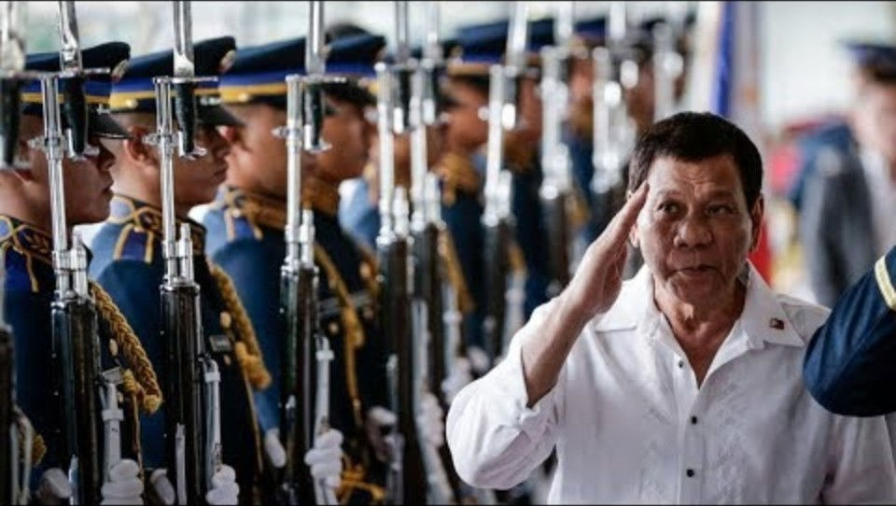
What do these clips show us about Duterte?
Notes:
CONTENT WARNING – Some of his quotes deal with rape and murder. Make sure to pre-view and consider how appropriate this clip is for your class.

Slide 5
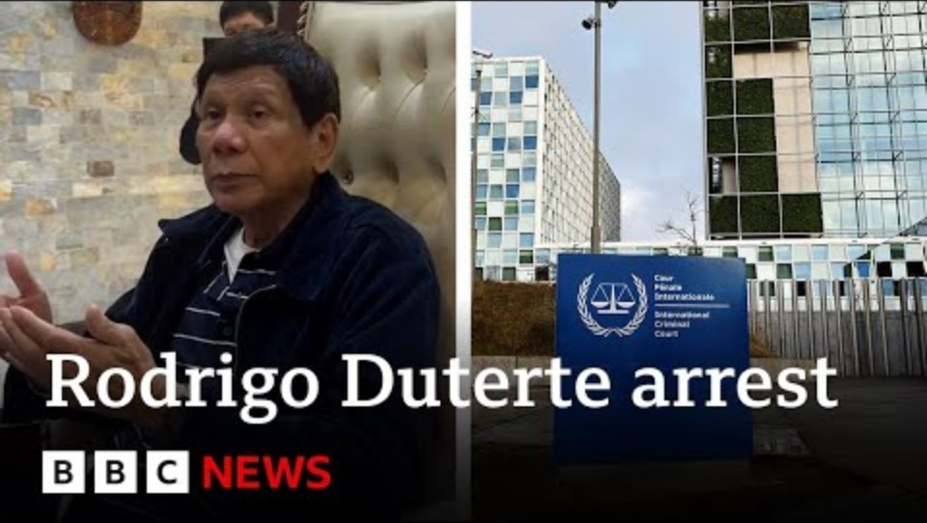
What was Duterte arrested for?

Slide 6
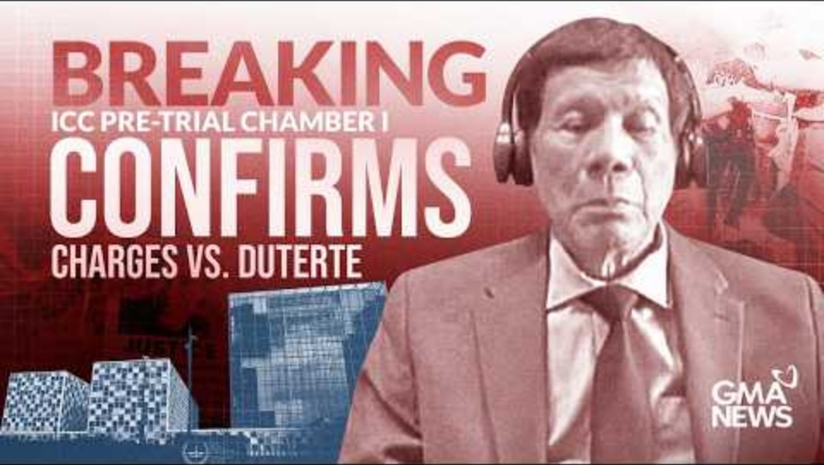
What are the next steps in the case?

Slide 7
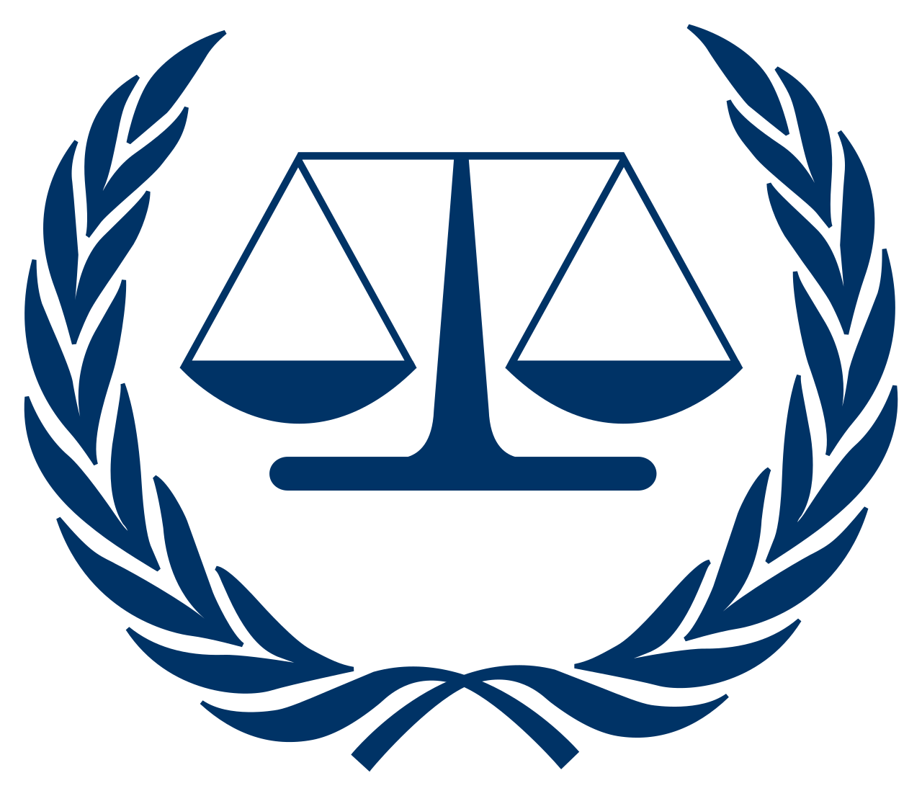
Further Research
Research another case of the International Criminal Court:
  Who was put on trial – where were they from?
  What were charged with?
  What was the verdict?
  What was the sentence – if any?
Can you perhaps use that case to predict what might happen in the Duterte case?
International Criminal Court (ICC) logo

