Slide 1
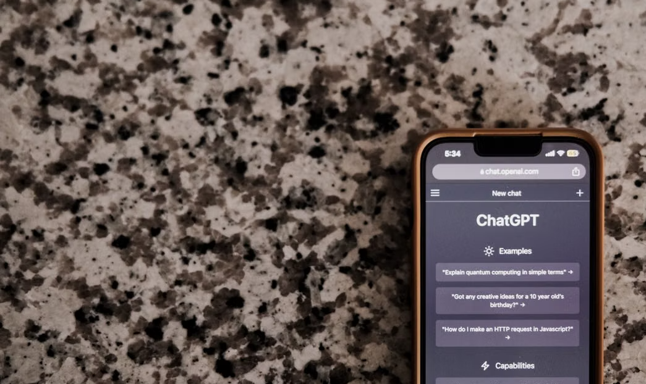

EU Artificial Intelligence Law
Power and Globalization
Is it beneficial to regulate artificial intelligence?
Notes:
Photo by Airam Dato-on: https://www.pexels.com/photo/close-up-of-a-smartphone-displaying-a-conversation-with-chatgpt-15940011/

Slide 2

What makes a technology law good?
Make a list of things that you think are important for a good technology law.
Think for a minute and then discuss with a partner.
Notes:
ANTICIPATED RESPONSES
It should be fair.
It should be clear / easy to understand.
It should protect people.
It shouldn't ban everything.
It should stop scams and fake stuff.
It should keep kids safe.
Companies shouldn't get to do whatever they want.
IDEAS TO FURTHER DISCUSSION
"Who decides whether it's fair?"
"How would anyone actually check that a company followed it?"
“Does it cost a big company and a small one the same?"
"Would you still call that a good rule if it applied to something you liked doing?"
"Does it matter whether the people affected voted for it?"
"Should a rule made in one country apply to a company in another?“
IF DISCUSSION STALLS
Point at a rule they already live under: the phone policy in your school. Is it a good rule? What makes it good or bad?
Photo by Beyzaa Yurtkuran: https://www.pexels.com/photo/a-laptop-with-the-chatapit-logo-on-it-16245253/

Slide 3

What does the EU law try to do? Why?

Slide 4
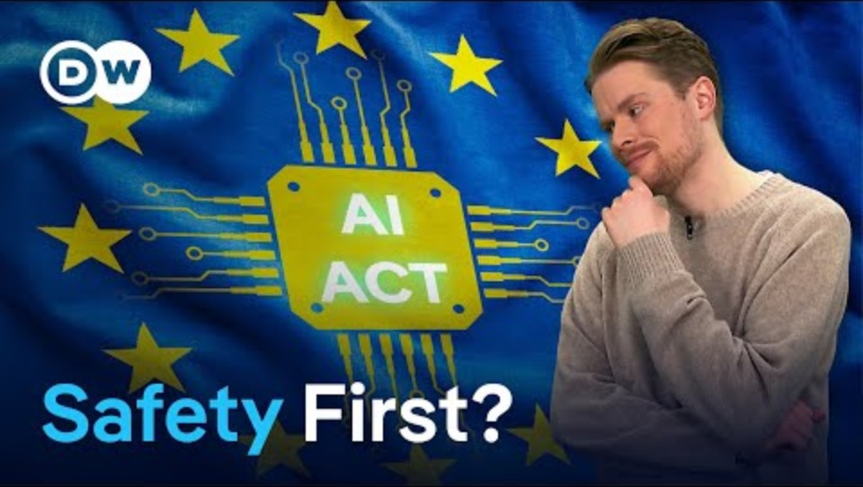
What are the pros and cons?
Notes:
This is an older video from when the act was first passed and parts came into force. As of August 2026, all tiers are now being enforced – the video mentioned this will happen – it has now happened.
The video also compares other countries which could be used as part of the discussion.

Slide 5
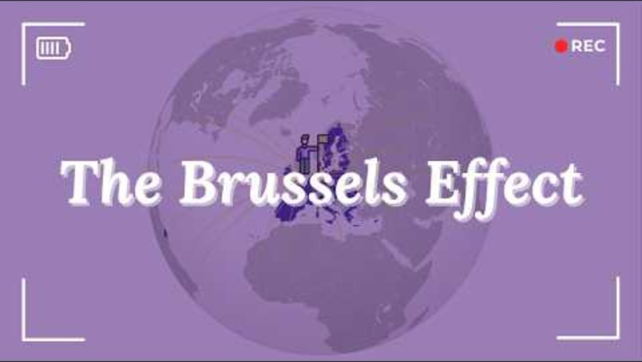
What is the “Brussels Effect”?

Slide 6
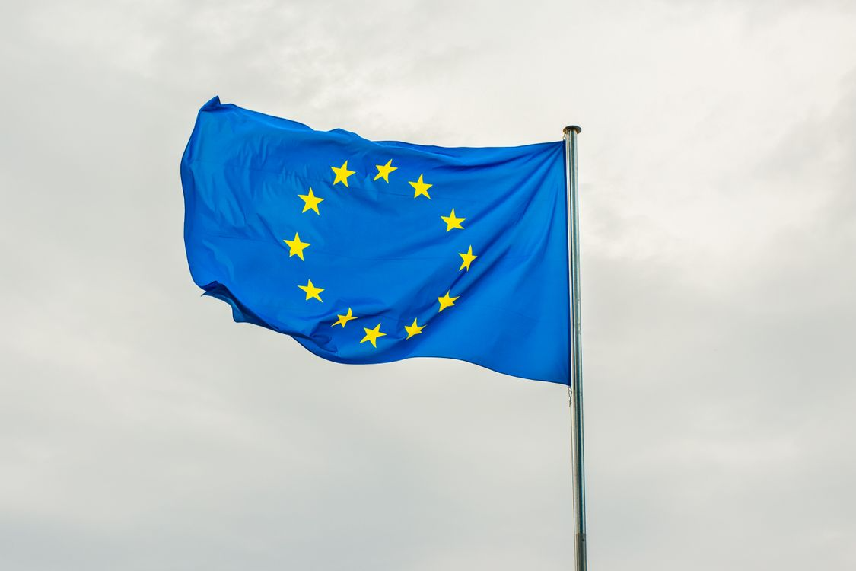
How might the EU AI Law affect other countries?
Consider what you just learned about the ‘Brussels Effect’. How might this new AI law end up affecting other countries around the world?
Notes:
Link back to the video – AI companies might now change their transparency policies for everyone, because it’s cheaper and easier for them to only have one model for the whole world.
Photo by Dušan Cvetanović: https://www.pexels.com/photo/eu-flag-swaying-with-the-wind-12541596/

Slide 7
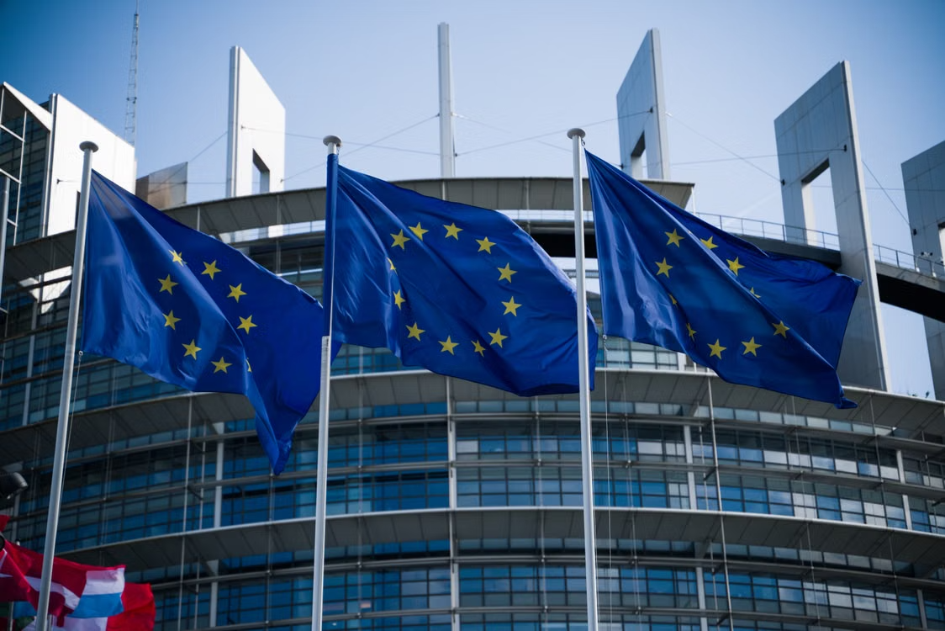
Further Research
Investigate the “Brussels Effect”. What other examples are there of EU laws that have shaped laws and policies in different parts of the world?
Notes:
Photo by Tim Diercks: https://www.pexels.com/photo/european-union-flags-at-strasbourg-parliament-39049421/

