Slide 1
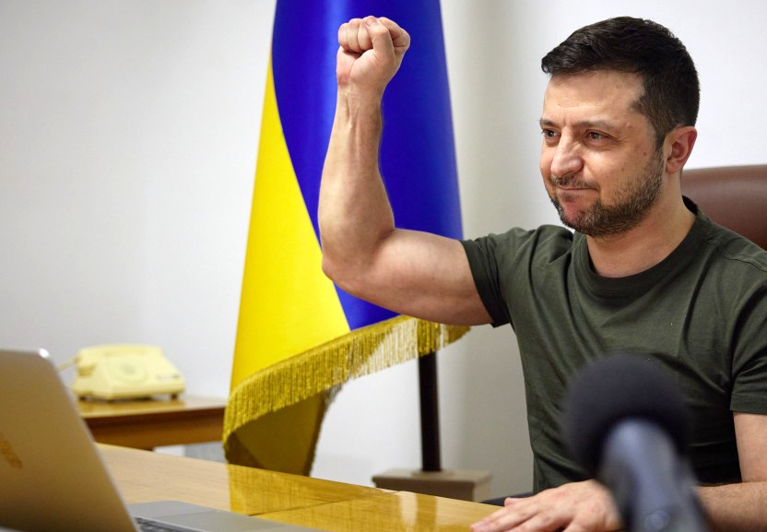

Ukraine Resists Russian Invasion
Sovereignty and Interdependence
What helped Ukraine resist the initial Russian invasion?
Notes:
Photo By President.gov.ua, CC BY 4.0, https://commons.wikimedia.org/w/index.php?curid=116245450

Slide 2
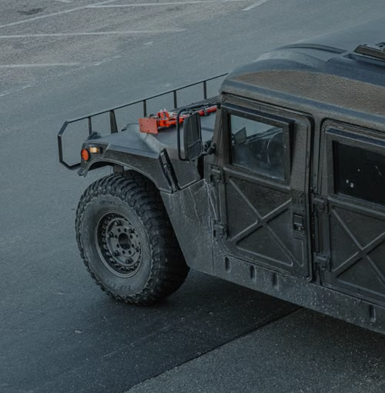
Discussion
What might a less powerful country need to defend itself against a more powerful country?
Notes:
The goal of this discussion is a messy, unsorted board of student-generated factors that the lesson will organize and make sense of. Do not necessarily steer toward the "right" answers. A board that includes wrong or partial answers is more useful, because the reading then has something to compare to.
Anticipated student responses
Weapons and equipment: "better weapons," "missiles," "drones," "tanks."
Allies and outside help: "other countries send help," "join an alliance," "NATO."
People and will: "people willing to fight," "not giving up," "defending their homes."
Terrain and geography: "mountains," "hiding," "knowing the land."
Leadership: "a good leader," "someone who stays."
The stronger side's errors: rare, and worth highlighting when it appears. If a student says "maybe the big country messes up," let them know it was ingightful: most people only think about what the weaker side does.
Information and communication: "getting the world to notice," "media.“
Questions to push the discussion deeper:
"You said weapons. Where do those come from?“
"Which of these could a country prepare in advance, and which only appear once fighting starts?“
If you’re having trouble getting discussion going:
"Think of any contest where the smaller side wins. For example a game, a court case, a race. What does the underdog need?“
Photo by Jacob Moore: https://www.pexels.com/photo/hummer-h1-truck-10981348/

Slide 3
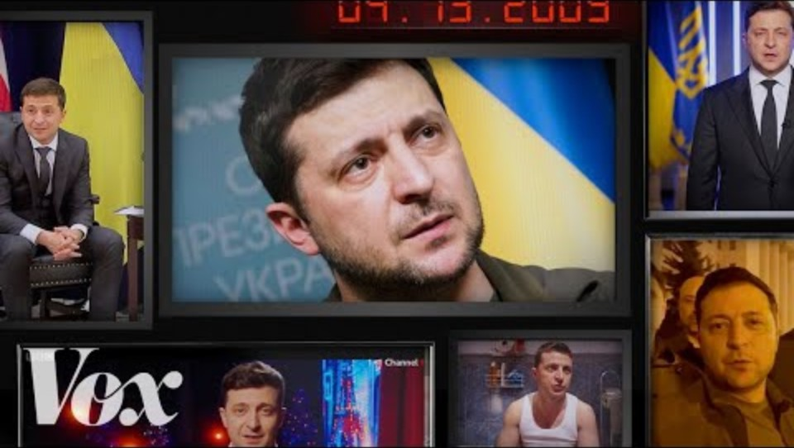
Who is Volodymyr Zelenskyy?
Notes:
Have students make a list of some interesting/important facts about the Ukrainian President.

Slide 4
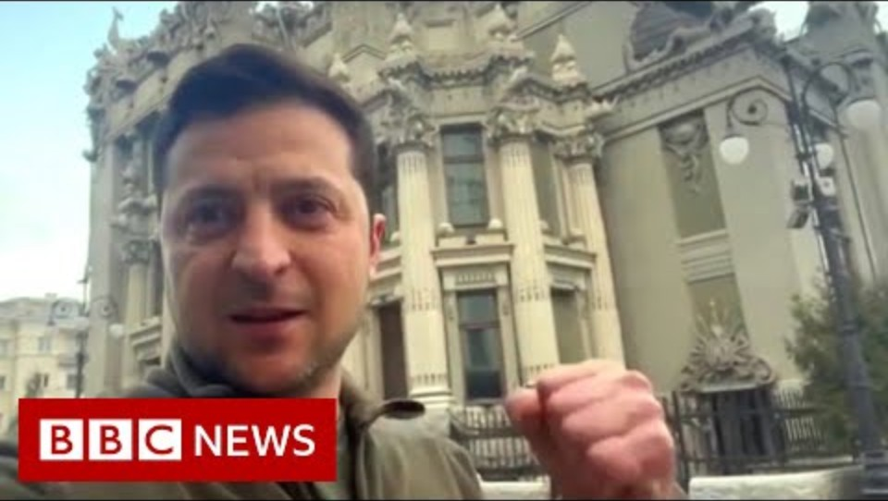
How did Zelenskyy respond to the invasion?
Notes:
His ‘I need ammunition, not a ride’ quote from this video is a good link to the reading.

Slide 5
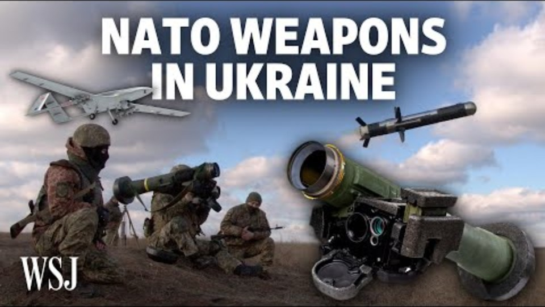
Which countries supported Ukraine during the initial invasion?
What kind of support did they get?

Slide 6
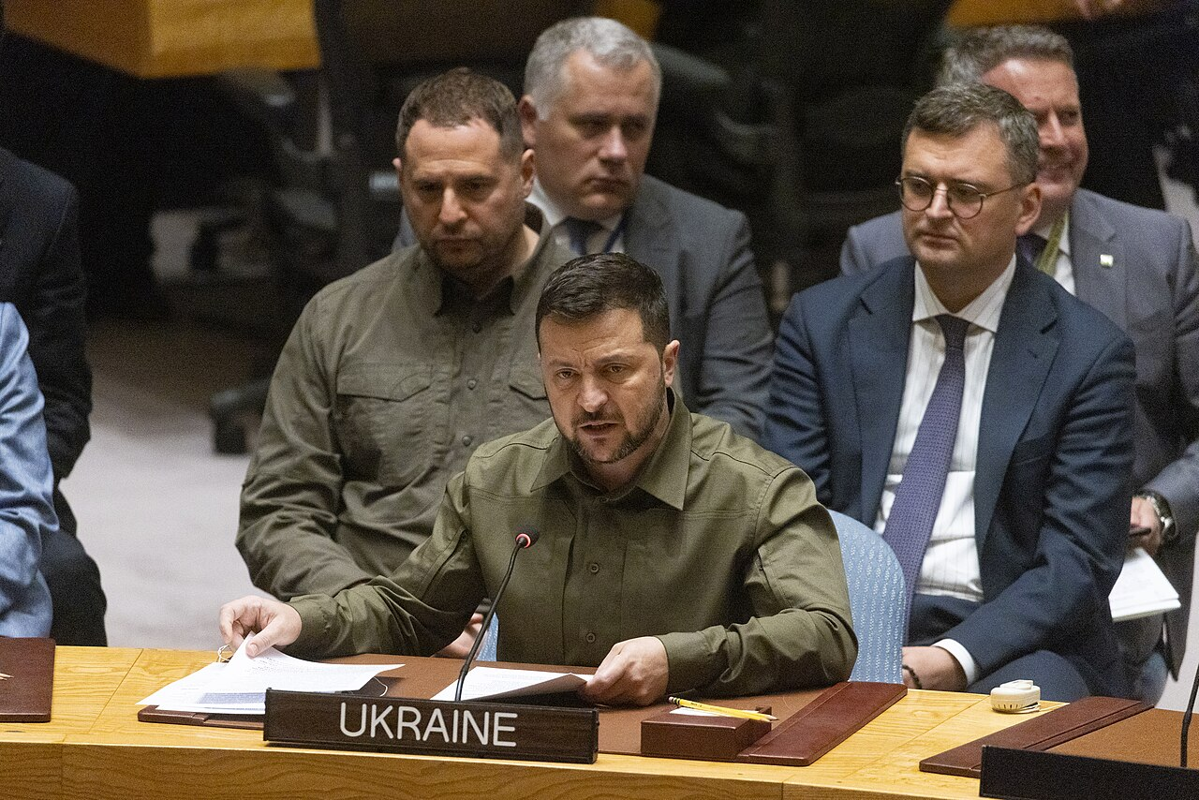
Further Research
Research the resistance in more detail. Find two events where Ukraine successfully resisted Russia that occurred between February and April, 2022. Make a list of internal and external factors that contributed to Ukraine’s success.

